Slide 1


Intro to the Tidyverse
Sign In & Code Link: go.osu.edu/BDAAsignin
Notes:
Raise hand for Questions
Thumbs up for TAs

Slide 2
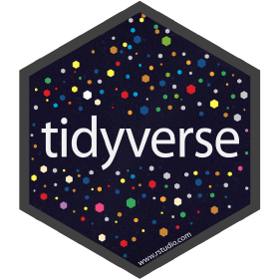



Plan
Explore a Dataset with Tidyverse (ggplot2 & dplyr)
Brief Intro to R & RStudio
Tidyverse Overview

Slide 3


R, RStudio, & Packages
R is an open source programming language for statistical computing and graphics supported by the R Foundation for Statistical Computing.
RStudio is a free “integrated development environment” (IDE) for R. It is the environment and interface we will be using today to execute our R code.
R packages are a collection of R functions, compiled code and sample data. They are stored under a directory called "library" in the R environment.
Notes:
Packages - “boilerplate” code

Slide 4
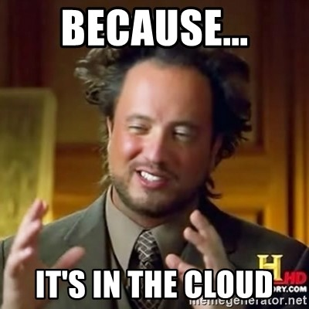
Getting Started with R
RStudio Cloud:
https://go.osu.edu/BDAA_TIDYCODE
Notes:
Desktop RStudio is fine too

Slide 5
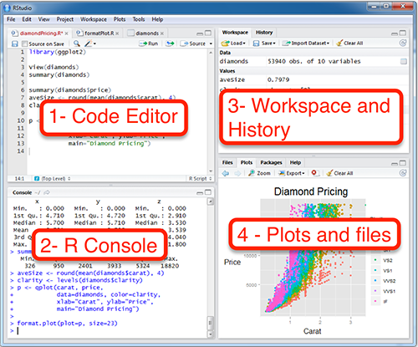
http://www.sthda.com/english/wiki/running-rstudio-and-setting-up-your-working-directory-easy-r-programming
Notes:
# difference between console & file editor
# create new file
# how to run code in file editor

Slide 6
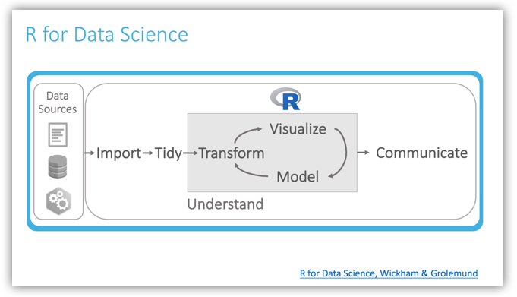
Why Tidyverse?
Notes:
Import
Tidy - consistent form. Each column is a variable and each row is an observation
Transform - subsetting, creating new variables, summary statistics
Visualization - shows unexpected, helps raise new questions, or shows that something is wrong, check model assumptions
Modeling - Scales well. Makes assumptions, thus a model cannot fundamentally surprise you.
Communication - purpose of data science is to solve problems by making informed changes in a positive direction

Slide 7

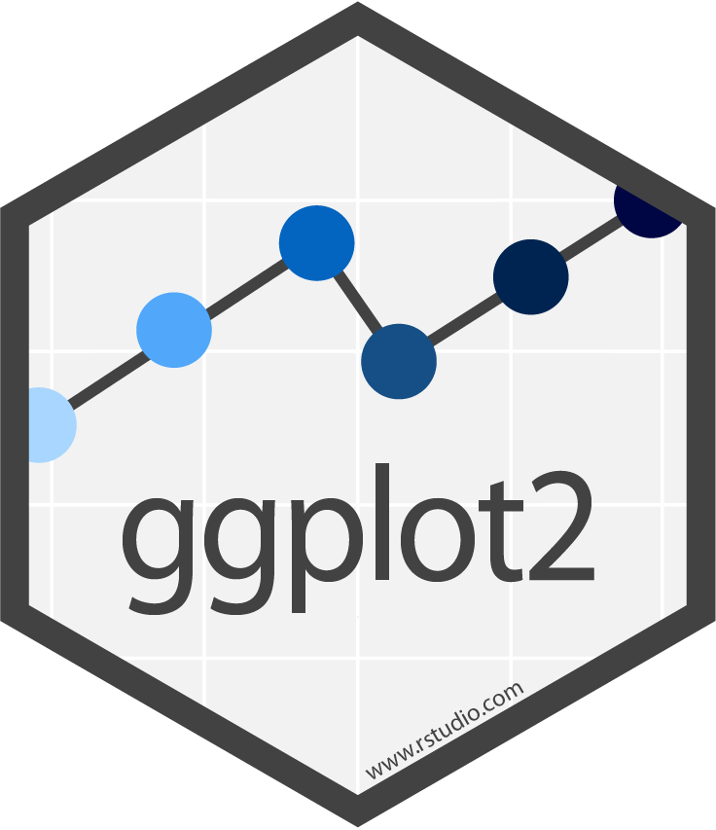

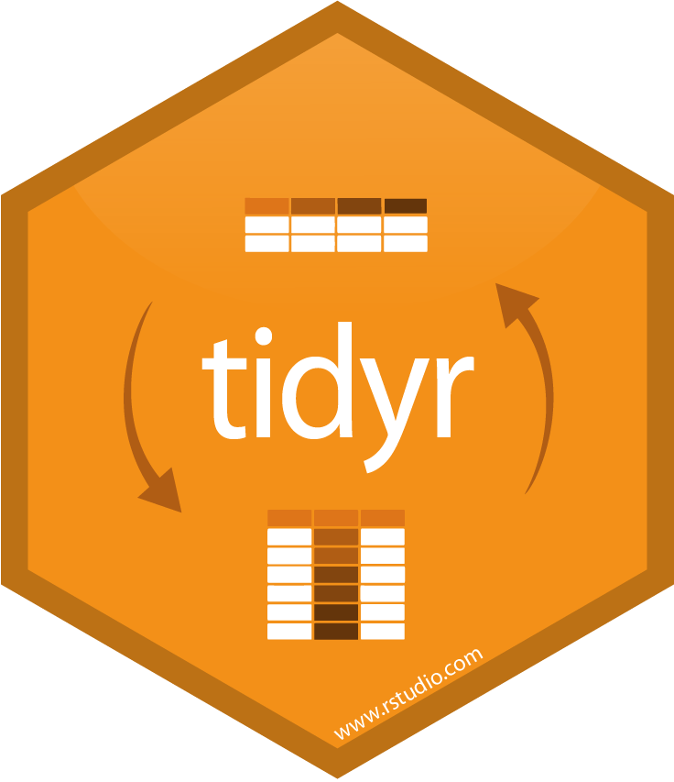
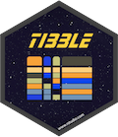



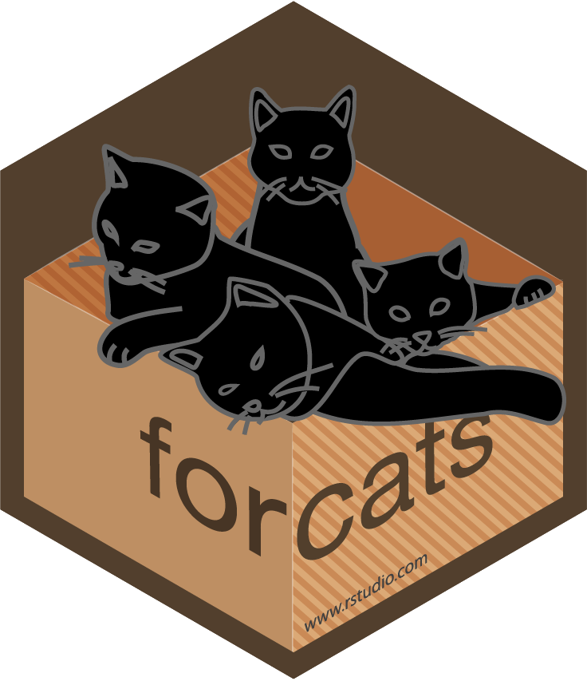
Tidyverse is Built For the Data Science Process
A collection of extremely useful (and open source!) data science packages
Created by Hadley Wickham
Core Tidyverse:

Slide 8
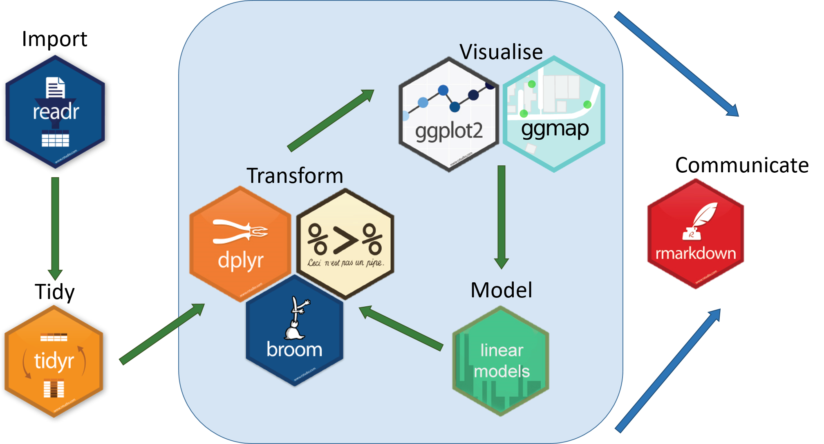
Tidyverse is Built For the Data Science Process
https://ourcodingclub.github.io/2017/03/20/seecc.html

Slide 9
Installing and Loading Tidyverse
Install all the packages in the tidyverse:
install.packages("tidyverse")
Load the core tidyverse:
library(tidyverse)

Slide 10

The Dataset
https://bdaa-workshops.s3.us-east-2.amazonaws.com/AB_NYC_2019.csv

Slide 11
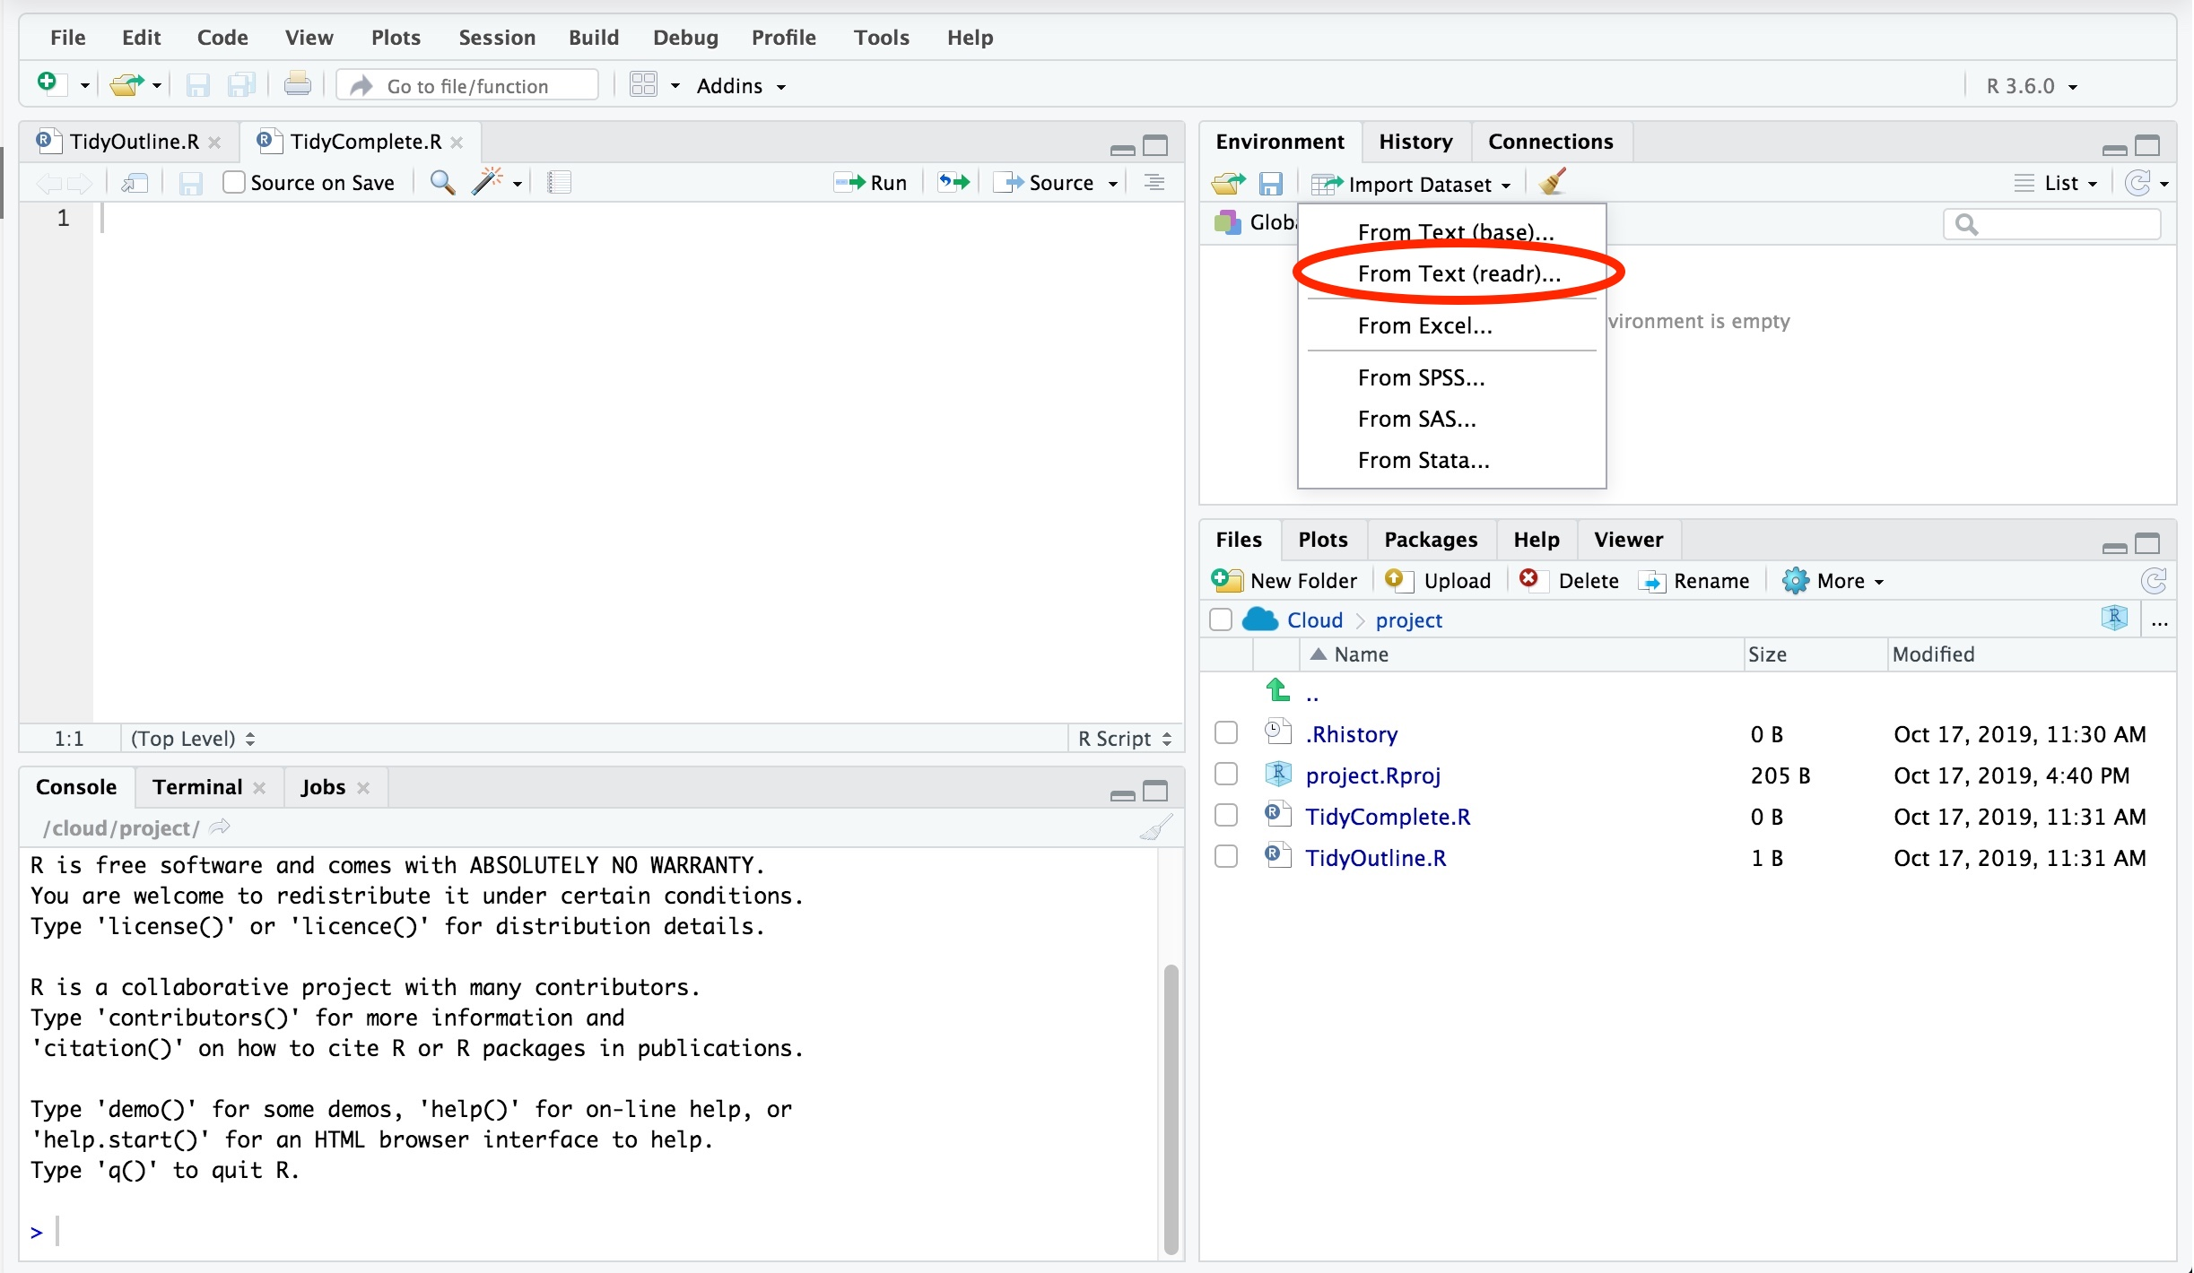
Importing the Dataset
readr is a package for importing ‘rectangular’ (.csv, tsv., etc.) files
df = read_csv(“datafile.csv”)
For more complex data:

Slide 12
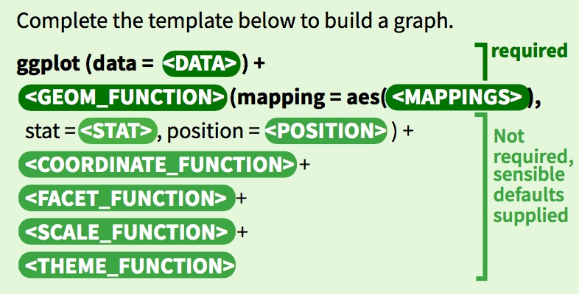
ggplot2
Package for declaratively creating graphics
Based on The Grammar of Graphics
https://ggplot2.tidyverse.org/#cheatsheet
Notes:
every function is added on with a “+”
formatting note: “+” must be at end of the line after the function

Slide 13
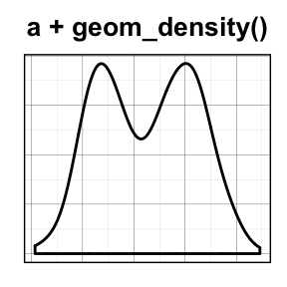
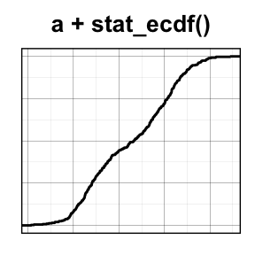
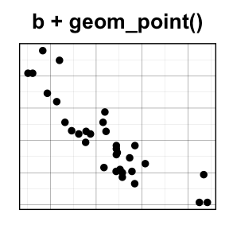
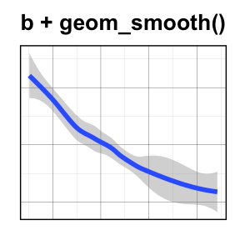
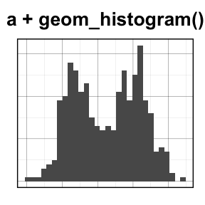
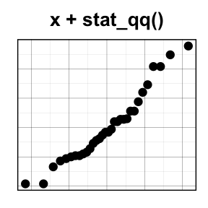
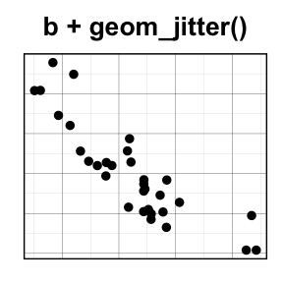
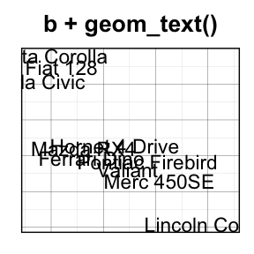
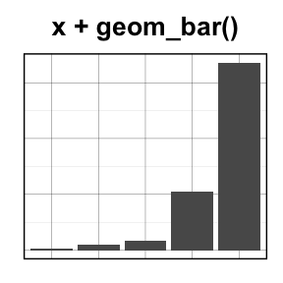
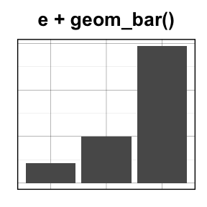
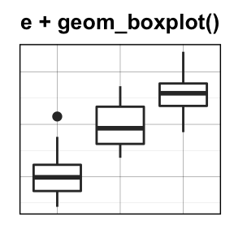
One Variable
Two Variables
X Continuous
X & Y Continuous
X Discrete
X Disc., Y Cont.
http://www.sthda.com/english/wiki/be-awesome-in-ggplot2-a-practical-guide-to-be-highly-effective-r-software-and-data-visualization

Slide 14
Let’s Explore our Dataset

Slide 15
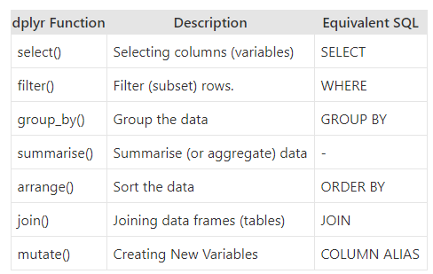
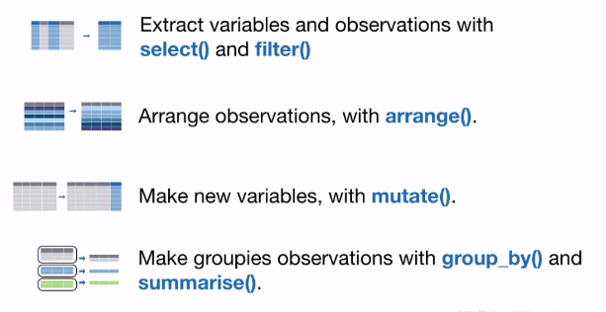
dplyr
Package for manipulating data

Slide 16
The Pipe Operator %>%
Connects a series of statements
“Pipes” LHS result as the first argument of the RHS function
Read as “then”
Equivalent
filter(select(cars_df, model, num_doors), num_doors == 2)
cars_df %>%
select(model, num_doors) %>%
filter(num_doors == 2)
brand | model | num_doors
Toyota | Venza | 4
Nissan | Murano | 4
Ford | Mustang | 2
model | num_doors
Venza | 4
Murano | 4
Mustang | 2
model | num_doors
Mustang | 2

Slide 17

Questions and Feedback
Any Questions?
Anonymous Feedback Survey:
https://go.osu.edu/bdaa_workshop_survery

Slide 18
Further Resources
Learning Tidyverse: https://www.tidyverse.org/learn/
R for Data Science Book: https://r4ds.had.co.nz/
Pipe Style Guide: https://style.tidyverse.org/pipes.html
My Contact Info:
Leo Glowacki
glowacki.25@osu.edu
www.leoglowacki.com

